Slide 1


Designing Scalable and User-Intensive Enterprise Applications
Date (02 November 2022)
Suresh Kumar Mukhiya, PhD, Tryg Norge (www.skmukhiya.com.np)
Guest Lecture UIB

Slide 2
Agenda
Overview (User-intensive, Enterprise Application, Scalable Systems, Client, Server, DNS)
Single Server Setup
Database in Single Server Setup
Which Database to use?
Scalability
Load balancer
Database replication
Cache Tier
Content Delivery Network (CDN)
Data Centers
Take away

Slide 3
About Me
From Nepal
2014: Moved to Norway
2016: Masters in Information System (NTNU, Trondheim)
2021: PhD in Software Engineering, HVL, Bergen
Married, 4 years old daughter
Started as full stack developer since 2010, almost 12 years in IT
I like photography, fishing and writing books
Major focus: Software Architecture, Frontend Technologies, and Data Science.

Slide 4
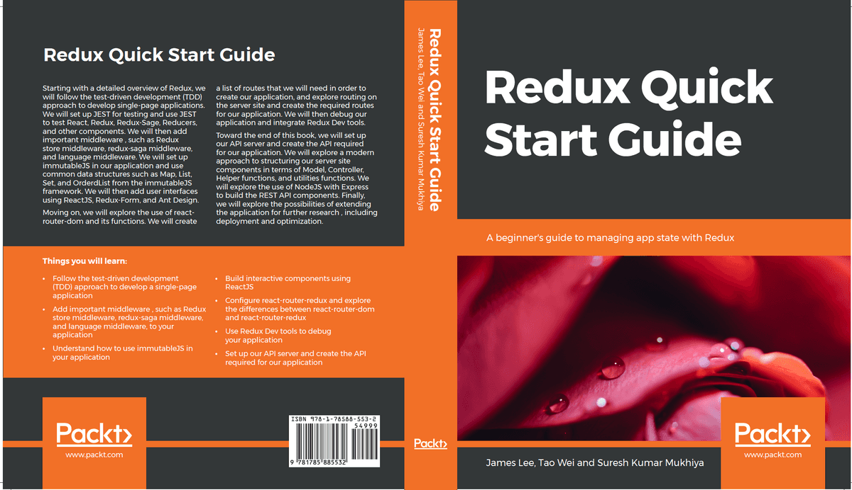

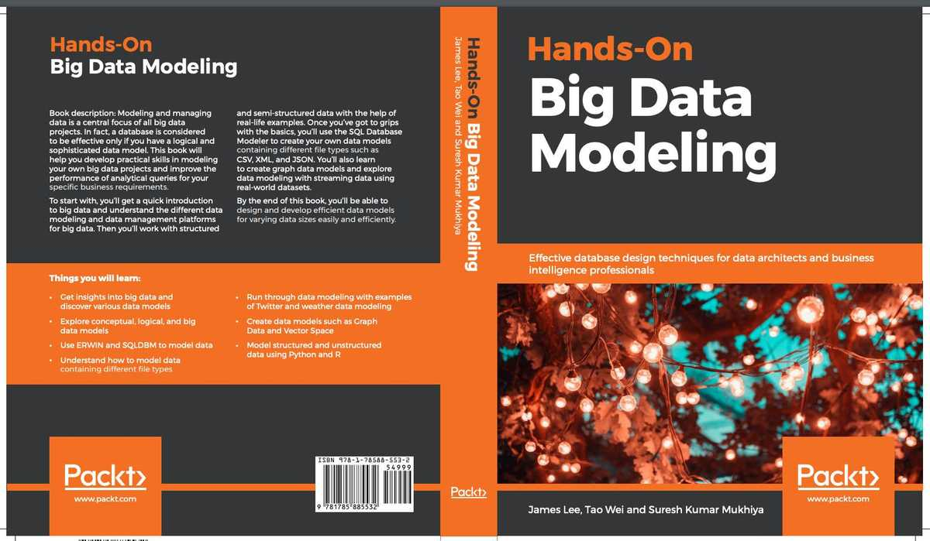
Published books

Slide 5
Overview
User-Intensive Application: can handle zero to million users. Example: Facebook, Netflix
Enterprise Application: An enterprise application (EA) is a large software system platform designed to operate in a corporate environment
Scalable System: An application that can handle a growing number of users and load, without compromising on performance
Kahoot

Slide 6
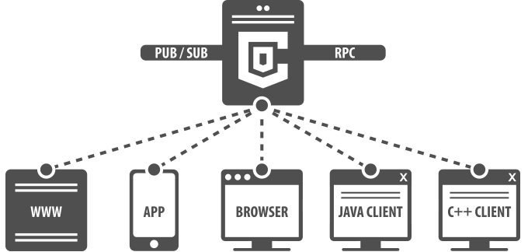
Overview – Client/ Server

Slide 7
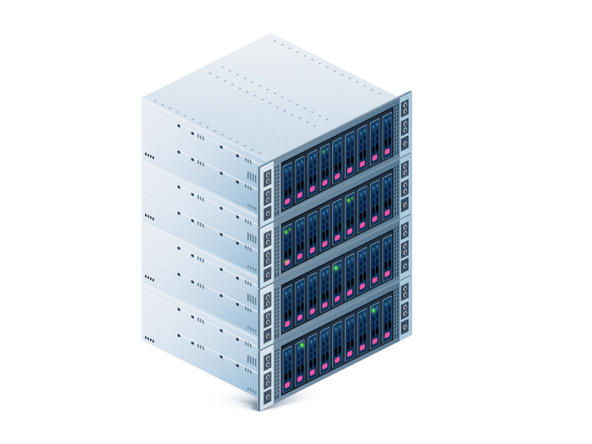
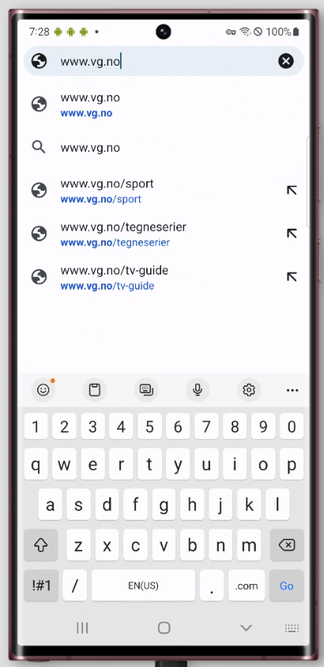
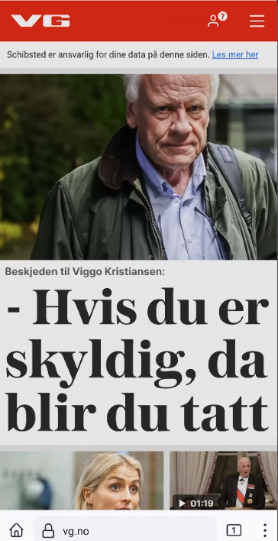
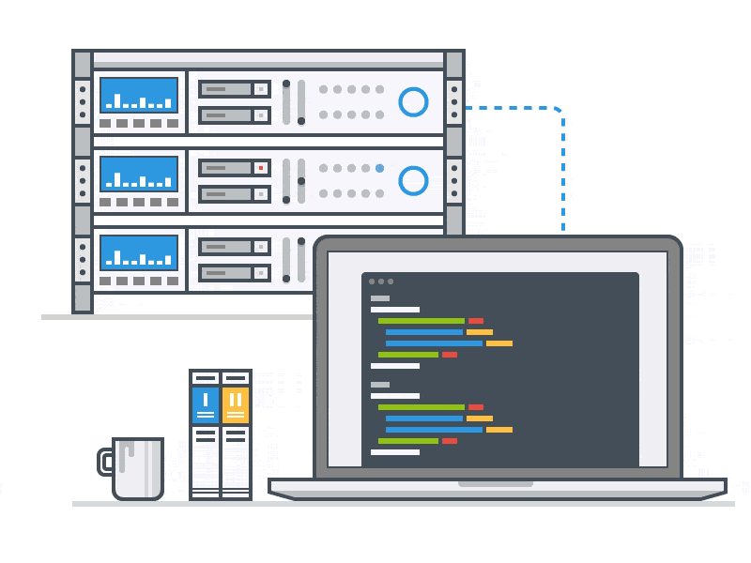
Overview – Domain Name Server (DNS)
Domain Name
Server (DNS)
1. Where is www.vg.no?
2. It is at IP http://195.88.55.16
Web Server
3. OK, http://195.88.55.16
4. Here, is the content for vg.no

Slide 8
A journey of thousand miles begins with a single step.
Let us build an architecture for small group of user.

Slide 9
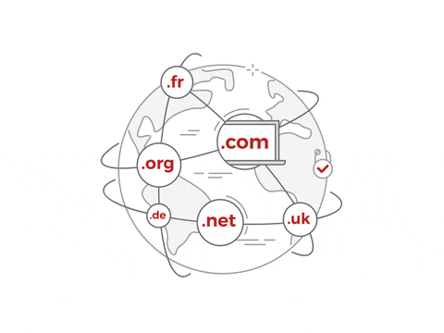
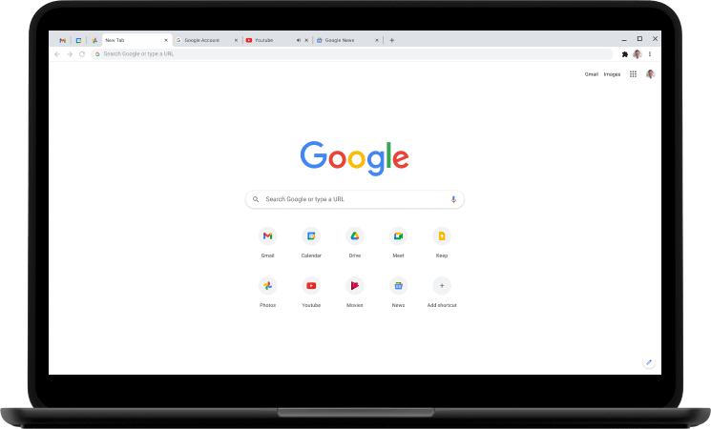
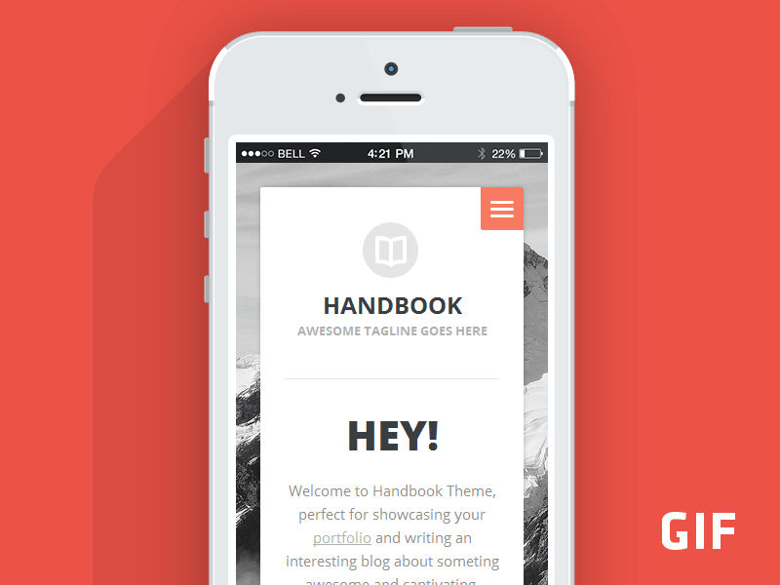
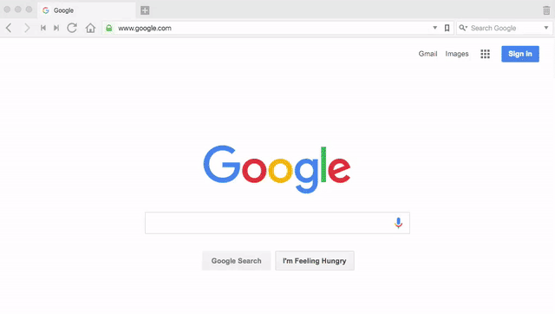
Single Server Setup
1. www.vg.no
DNS
Web browser
Mobile App
2. 195.88.55.16
3. 195.88.55.16
4. HTML Page
How does a client send data/resource/HTML page to client?
Using HTTP protocol over web services: REST API, GraphQL
Web server

Slide 10
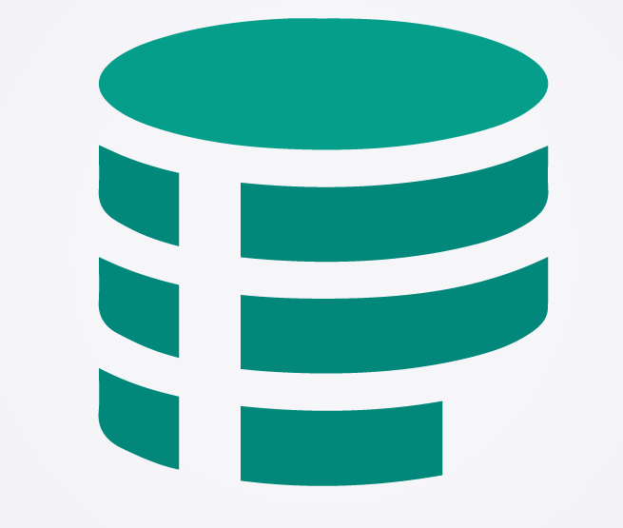
How does any server stores information?
Database
Let us include DATABASE in the single server setup.

Slide 11
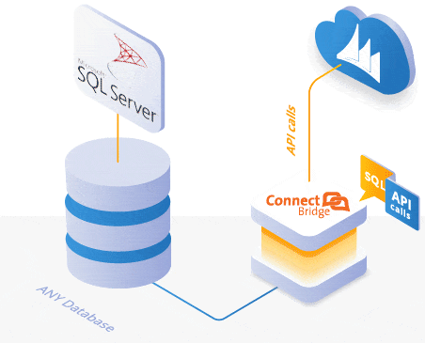
Database in Single Server Setup
1. www.vg.no
DNS
Web browser
Mobile App
2. 195.88.55.16
3. 195.88.55.16
6. show vg.no
4. read/write/update
5. Return data
Web server

Slide 12
Which Database to use?
A thought would be..

Slide 13
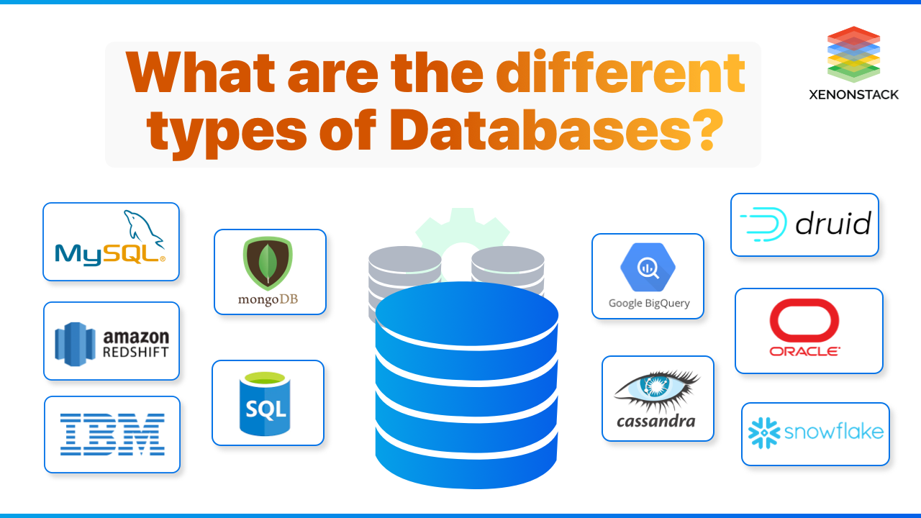

Slide 14
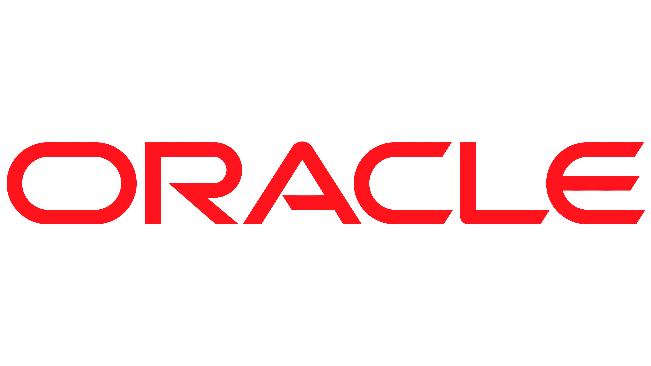
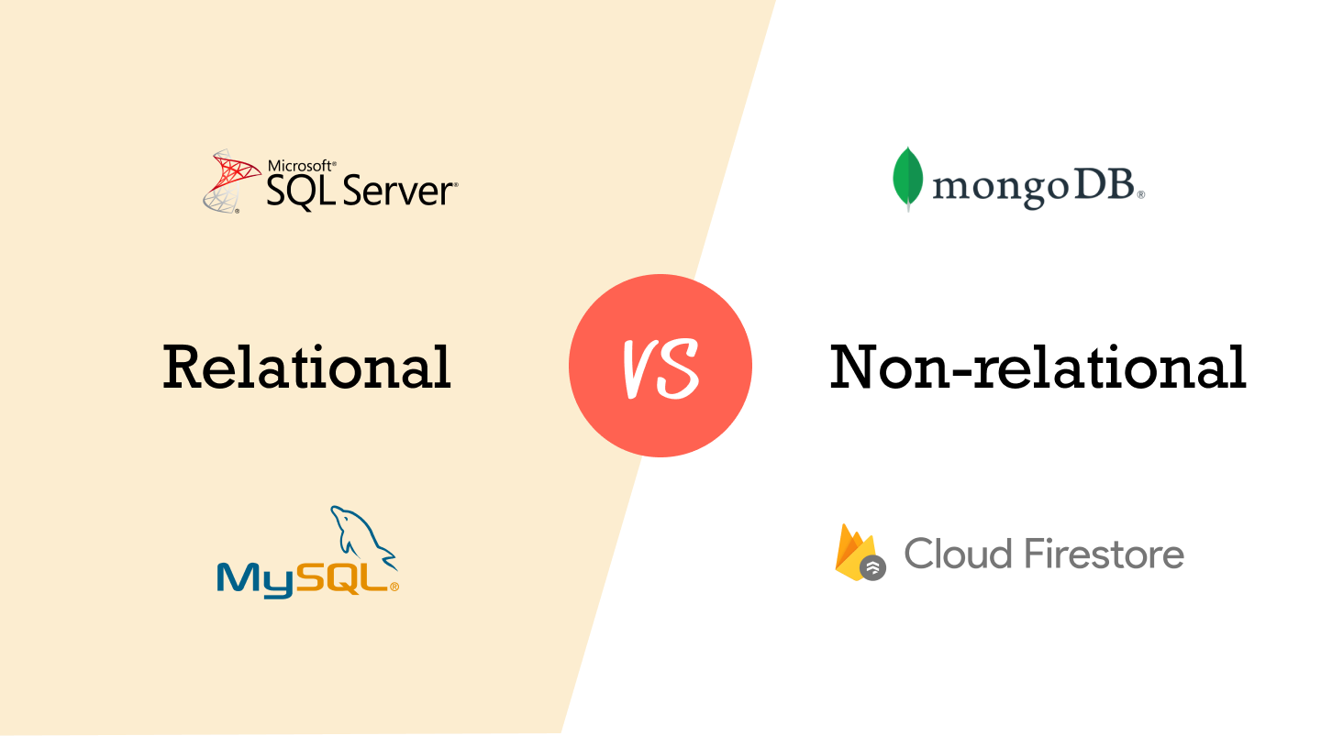

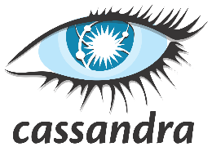
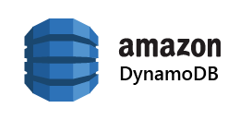
Relational Databases VS Non-relational database

Slide 15
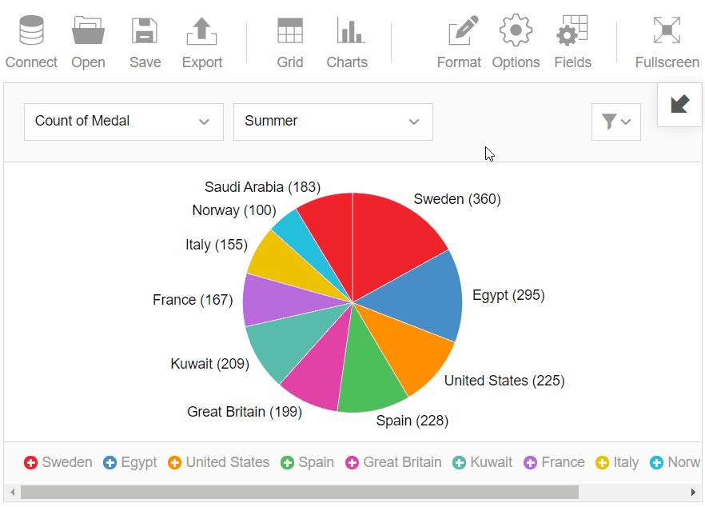
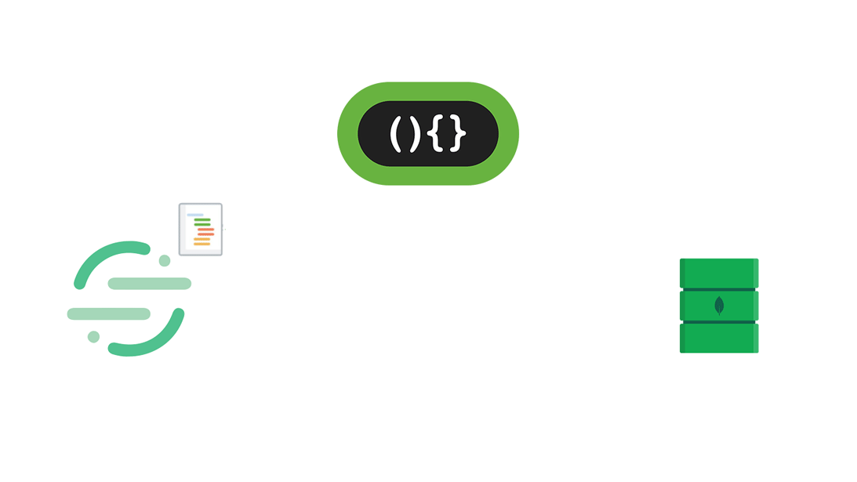
Relational Databases VS Non-relational database

Slide 16
When to use non-relational database?
If your application require super-low latency.
Your data is unstructured.
You need to store a massive amount of data.
You need to serialize and deserialize data (JSON, XML, YAML)

Slide 17
Back to the architecture
We were discussing Single Server Setup with Database.

Slide 18
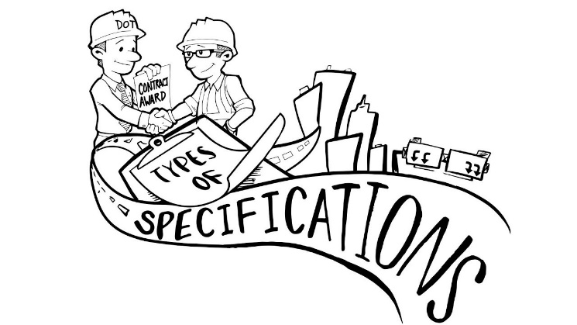
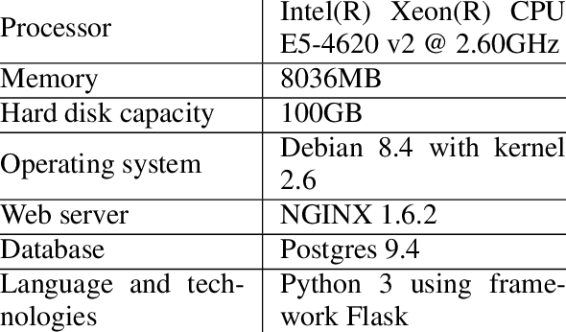
When you talk about servers?
It is just a computer with higher specification.
PORTS
Memory
Video Memory
Speed
Storage
CPU

Slide 19
Number of users increase, or you run out of specification?
What will you do if?
You will need to grow/increase your specification.
This concept is called as: ?

Slide 20
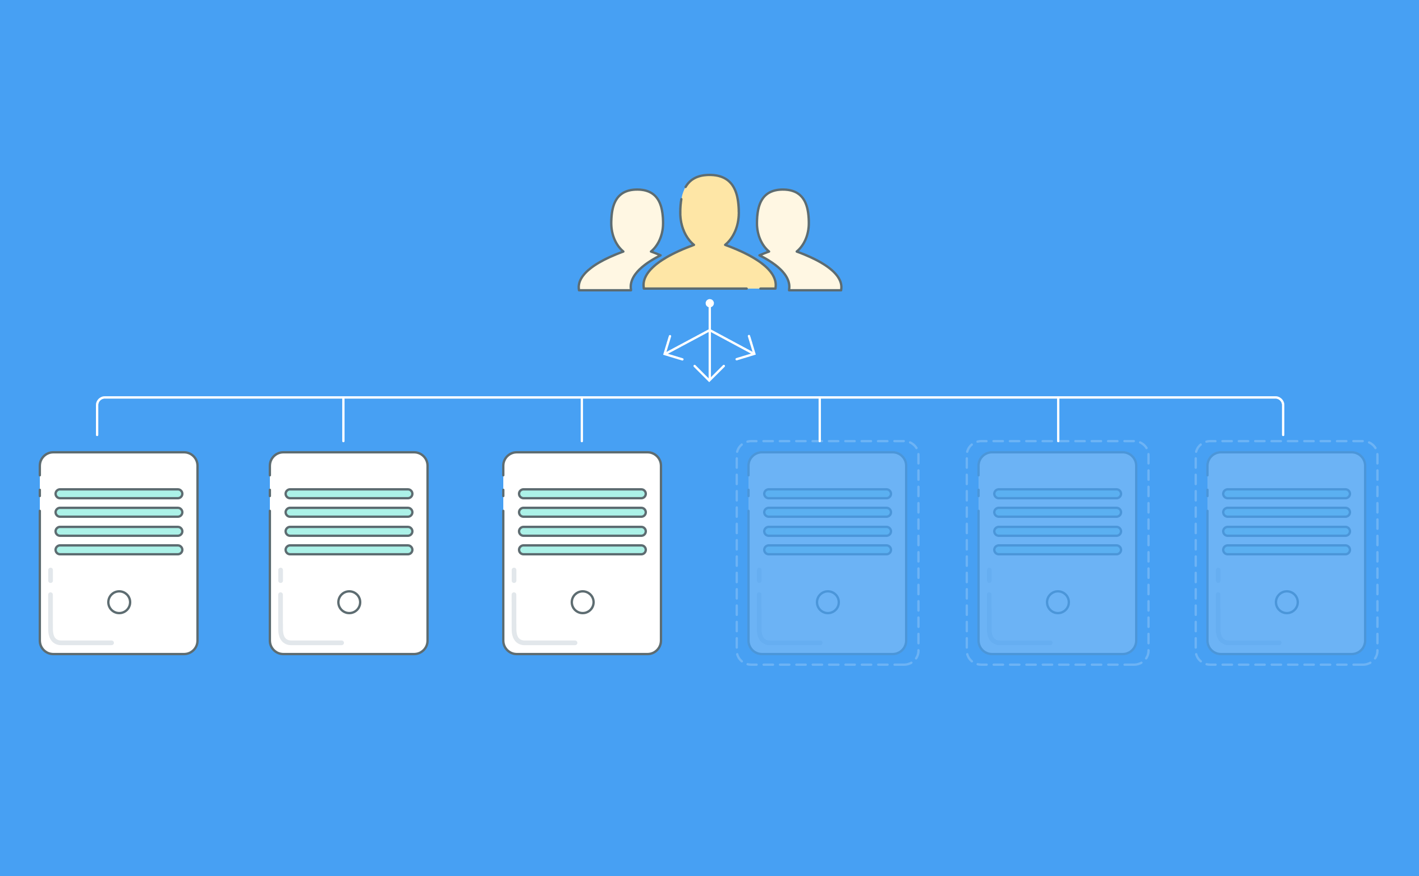
Scalability

Slide 21
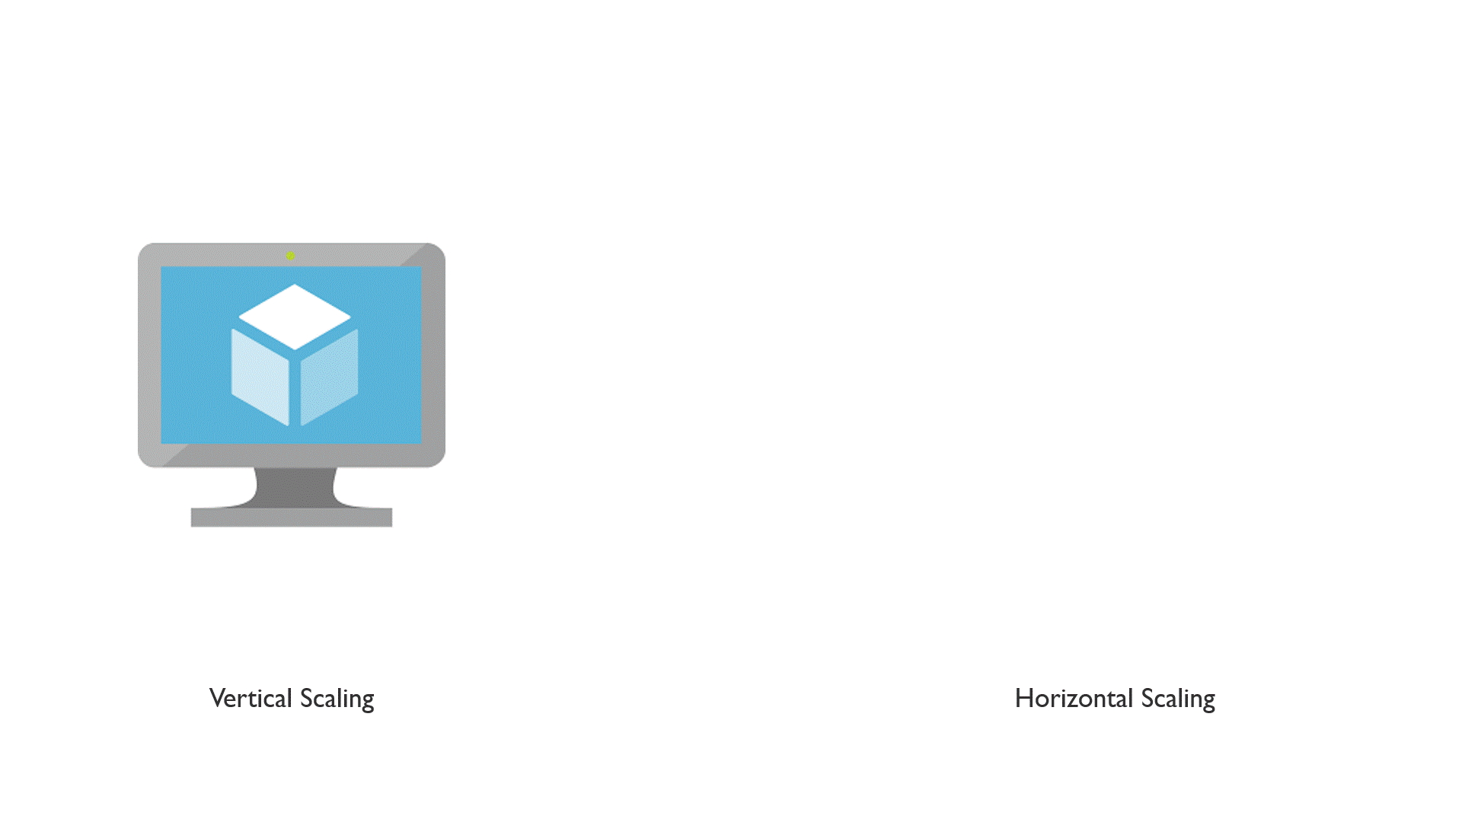

Slide 22
Scalability thoughts ……. ????
Vertical scalability works when traffic is low. It is simple to implement.
Impossible to add unlimited CPU and memory to any computer.
If server goes down, entire application goes down.
Horizontal scalability is more desirable for large scale applications.

Slide 23
Back to the single server setup.
Let us assume our userbase increases. Single Server Setup with Database will fail. We need to scale up.

Slide 24
Revisiting Database in Single Server Setup
1. www.vg.no
DNS
Web browser
Mobile App
2. 195.88.55.16
3. 195.88.55.16
6. show vg.no
If Web server goes down, the application will go offline.
4. read/write/update
Solution is to have multiple servers. So, if one goes down another is still active.
5. Return data
Web server

Slide 25

Let us increase one more server
www.vg.no
DNS
Web browser
Mobile App
195.88.55.16
How will client know which server to request data from?
show vg.no
195.88.55.16
show vg.no
195.88.55.16
Web server 1
Web server 2
This is where the concept of Load Balancer comes in.

Slide 26
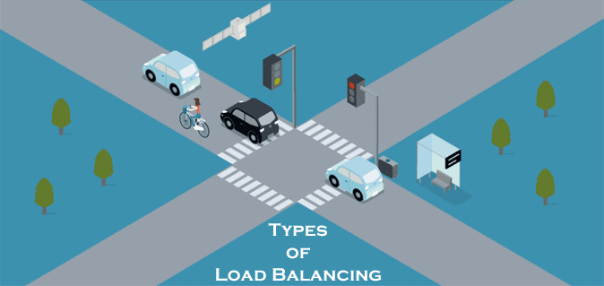
Real life load balancer: Traffic System

Slide 27
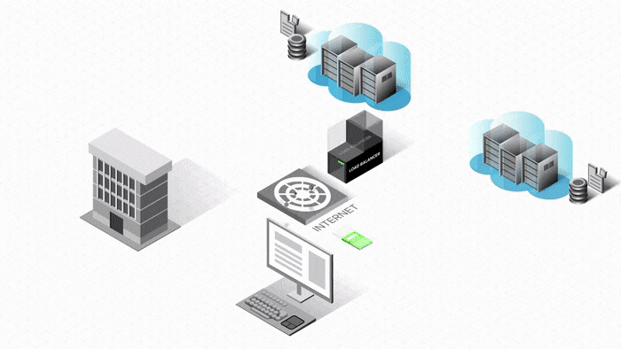
Let us put this concept into our architecture …
Web server 1
Web server 2
USER 2
If Web server 1 goes down, all traffic will be redirected to Web server 2.
USER 2

Slide 28
Let us include load balancer into our architecture
We know what a Load Balancer is:

Slide 29
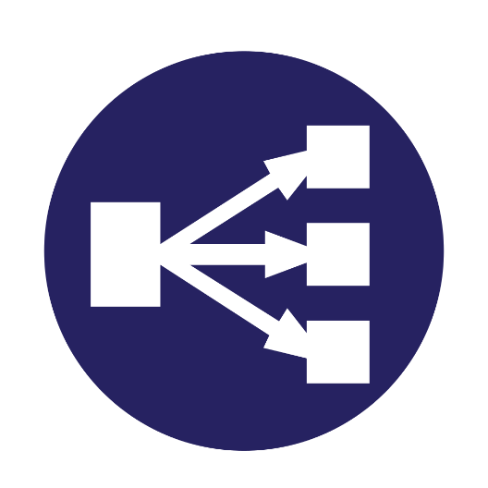
Let us include Load Balancer into our architecture.
195.88.55.16
User
Load Balancer
show vg.no
Web browser
Mobile App
www.vg.no
Private IP: 10.0.0.1
195.88.55.16
Private IP: 10.0.0.2
DNS
Web server 1
Web server 2
OSLO
Berlin

Slide 30

Let us see benefits of this architecture
195.88.55.16
User
Load Balancer
Software Quality Attributes
Mobile
show vg.no
Browser
Availability
www.vg.no
IP: 10.0.0.1
Private IP: 10.0.0.2
Scalability
195.88.55.16
Security
DNS
Web server 1
Web server 2
OSLO
Berlin
If Web server 1 goes down, all traffic will be redirected to Web server 2.
Web servers are unreachable directly. It provides better security.
If two servers are not enough, we only need to add more servers.

Slide 31
Two-server architecture with Database.
195.88.55.16
User
Load Balancer
show vg.no
Web browser
Mobile App
www.vg.no
Private IP: 10.0.0.1
195.88.55.16
Private IP: 10.0.0.2
DNS
Web server 1
Web server 2
OSLO
Berlin

Slide 32
P1: What about database failure…?
We solved server failure situation (By having multiple servers)
P2: What if database gets corrupted?

Slide 33
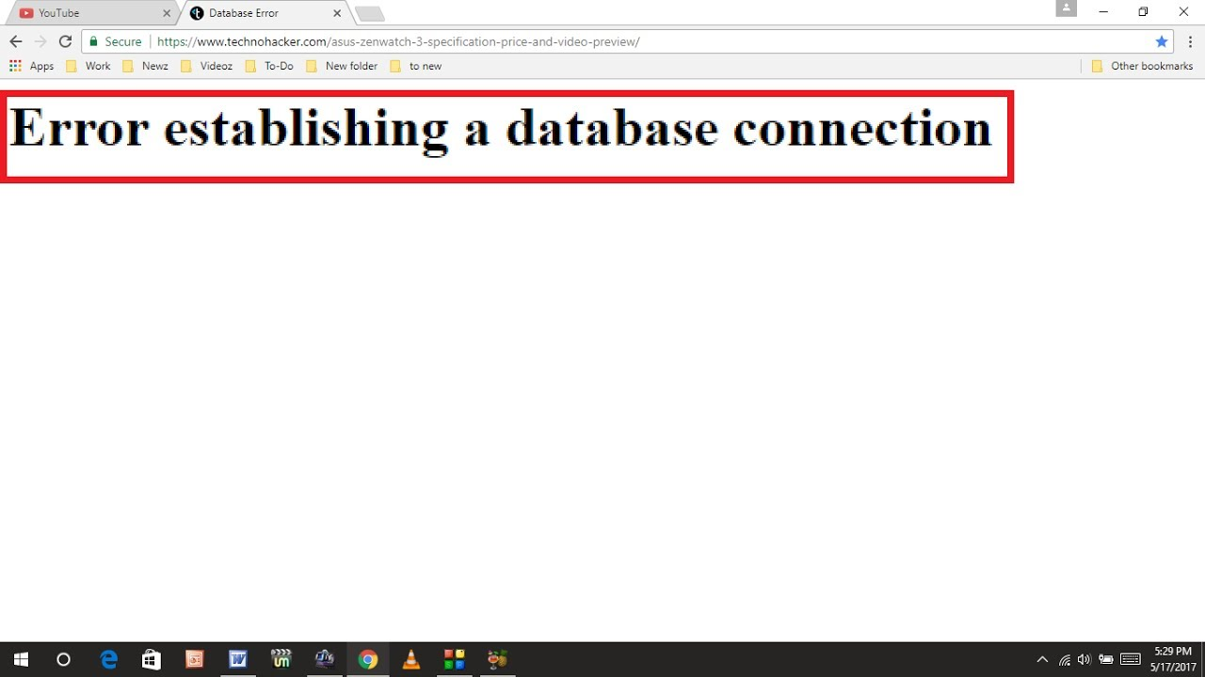
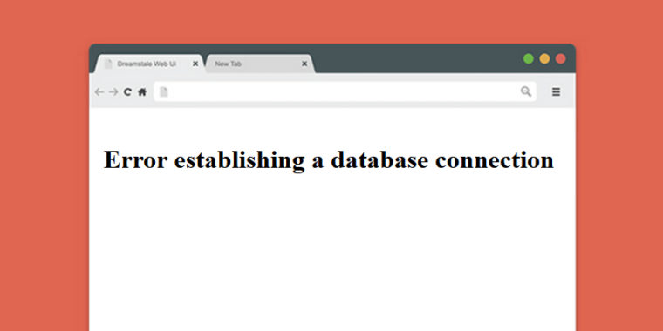
We solve these issues by a technique called database replication.

Slide 34
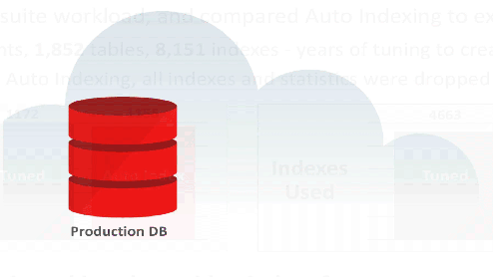
Database Replication
Database replication means making copies of the original database.
The original database is called master.
The database copy is called slave.
Web server
MASTER DB
SLAVE
SLAVE DB

Slide 35

Database Replication – Master and Slave
WRITE/UPDATE/DELETE
Master DB
Web server
READ
DB Replication
DB Replication
Slave DB3
Slave DB2
Slave DB1
READ
READ
READ

Slide 36

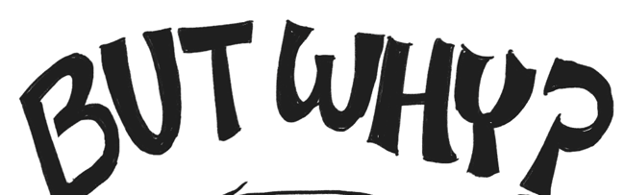

Slide 37
Database Replication – benefits
WRITE/UPDATE/DELETE
Master DB
Most application requires higher ratio of read to write. Hence n(slave) > n(master).
Web server
Better Performance: Read happens on slave, write happens on master, hence queries happens in parallel.
DB Replication
DB Replication
READ
Slave DB3
Slave DB2
Slave DB1
Reliability: If one server is destroyed by natural disaster, data is still preserved. No data loss.
READ
READ
READ
Availability: Databases are replicated across different locations. Web application remains active even if some database server fails.

Slide 38
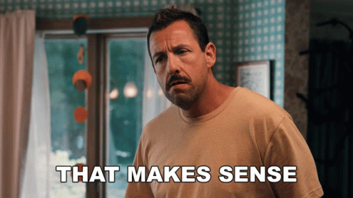

But what if a database goes offline?

Slide 39
What if one of the DBs goes offline?
WRITE/UPDATE/DELETE
If there is only 1 slave, and if it goes offline, read operations will be redirected to master DB temporarily.
Master DB
Web server
DB Replication
DB Replication
READ
If there is multiple slaves, and if one slave goes down, read operations are redirected to healthy slaves.
Slave DB3
Slave DB2
Slave DB1
READ
READ
READ
If master DB goes offline, a slave DB is promoted to master DB. Faulty is replaced/repaired and goes back to former process.
Master/slave management requires complex configuration.

Slide 40
Let us include DB replication into our 2-server architecture
We discussed database replication.

Slide 41
Two-server architecture with LB, DB replication
195.88.55.16
User
Load Balancer
show vg.no
Web browser
Mobile App
www.vg.no
195.88.55.16
Private IP: 10.0.0.1
Private IP: 10.0.0.2
DNS
WRITE/UPDATE/DELETE
WRITE/UPDATE/DELETE
Master DB
Master DB
Web server 1
Web server 2
DB Replication
DB Replication
READ
DB Replication
READ
DB Replication
Slave DB3
Slave DB2
Slave DB1
Slave DB3
Slave DB2
Slave DB1
READ
READ
READ
READ
READ
READ

Slide 42

Let us discuss how to improve the load / response time.
Now you have a solid understanding of Web Tiers and Database Tiers.

Slide 43
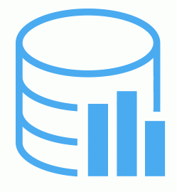
Cache – temporary storage
A temporary storage that stores the result of most expensive responses or most frequently accessed data.
1. Request expensive/frequent data
CACHE
Web server
2.1. if data exist in cache,
return cached data
2.2. if data NOT exist in cache,
Query database and send response
DB
Cache is much faster than actual database. The aim of cache is to increase system performance.

Slide 44
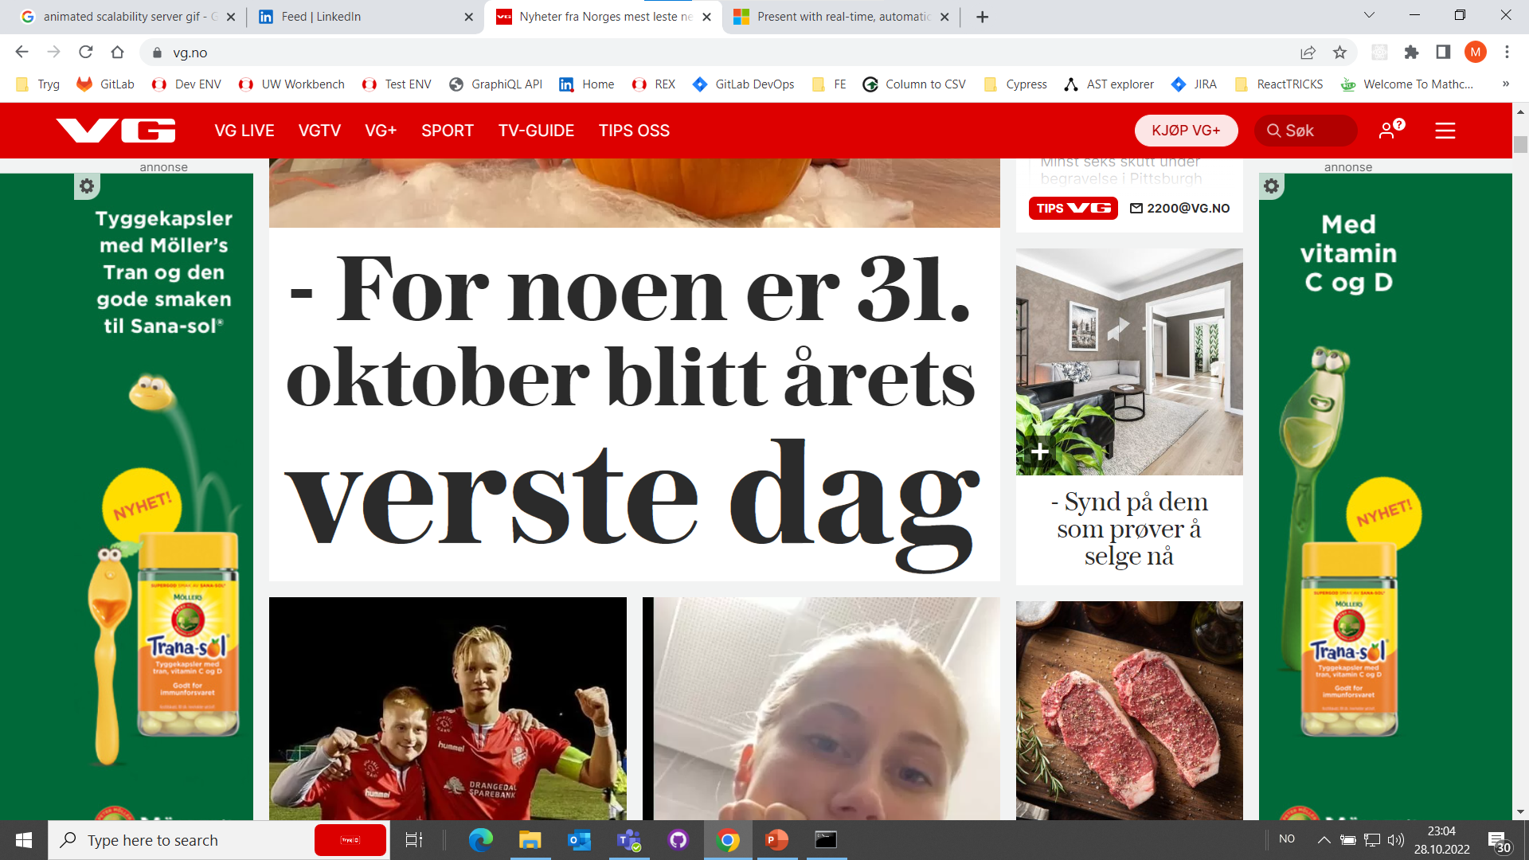
Static content in any web application

Slide 45

Content Delivery Network (CDN)
Static contents: Images, Videos, Icons, CSS, JavaScript Files etc.
The idea is to store static contents in one ore more CDN servers.
When a user visits a web application, CDN server closest to the user delivers static content. Dynamic content is fetched from Web Servers.
1. Get IMAGE1.PNG
2. If not in CDN,
get IMAGE1.PNG from server
User
Web browser
Mobile App
4.
2. Return IMAGE1.PNG
3. Store IMAGE1.PNG in CDN
www.vg.no
195.88.55.16
Web server
DNS

Slide 46
Let us include cache and CDN into our architecture.
Now you know the concept of cache, and CDN.

Slide 47
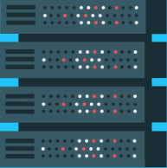
Two-server architecture with LB, DB replication, cache, CDN
195.88.55.16
get static content
Load Balancer
User
show vg.no
Web browser
Mobile App
CDN
www.vg.no
195.88.55.16
Private IP: 10.0.0.1
Private IP: 10.0.0.2
DNS
WRITE/UPDATE/DELETE
WRITE/UPDATE/DELETE
Master DB
Master DB
Web server 1
Web server 2
DB Replication
DB Replication
READ
DB Replication
READ
DB Replication
CACHE
CACHE
Slave DB3
Slave DB2
Slave DB1
Slave DB3
Slave DB2
Slave DB1
READ
READ
READ
READ
READ
READ

Slide 48
How about millions of users? Two servers are not enough. Need more.
Now you know the concept of client, server, cache, DB, CDN.

Slide 49
Multi-server architecture – Data Centers
195.88.55.16
get static content
Load Balancer
User
show vg.no
Web browser
Mobile App
CDN
www.vg.no
195.88.55.16
Private IP: 10.0.0.1
Private IP: 10.0.0.2
DNS
WRITE/UPDATE/DELETE
WRITE/UPDATE/DELETE
Master DB
Master DB
Web server 1
Web server 2
Data Centers
DB Replication
DB Replication
READ
DB Replication
READ
DB Replication
CACHE
CACHE
Slave DB3
Slave DB2
Slave DB1
Slave DB3
Slave DB2
Slave DB1
READ
READ
READ
READ
READ
READ

Slide 50
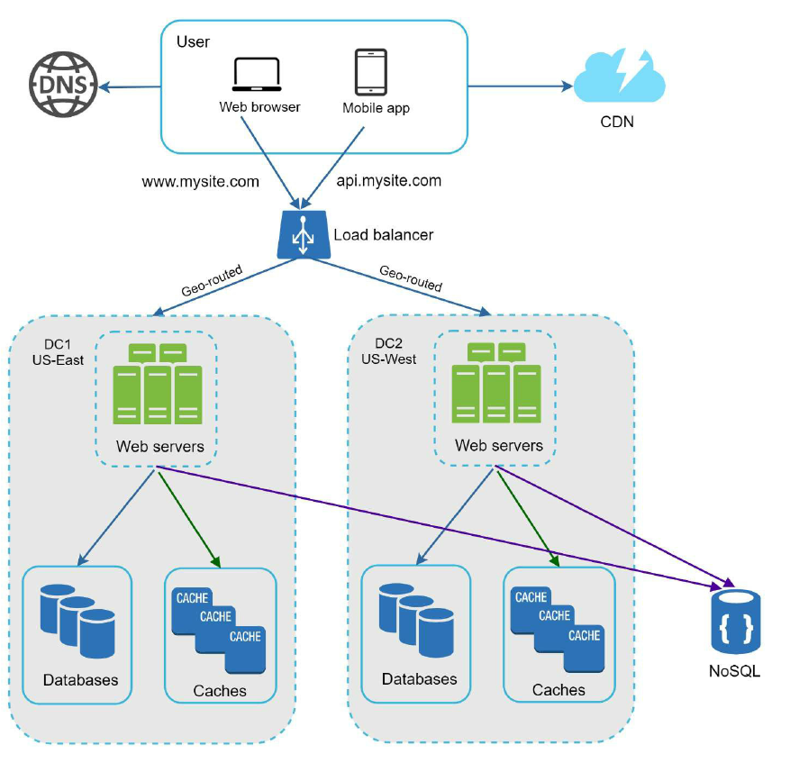
Architecture with shared DB
Two Data centers and with shared DB
Shared DB is used for most frequently stored Data like Authorization / Authentication

Slide 51
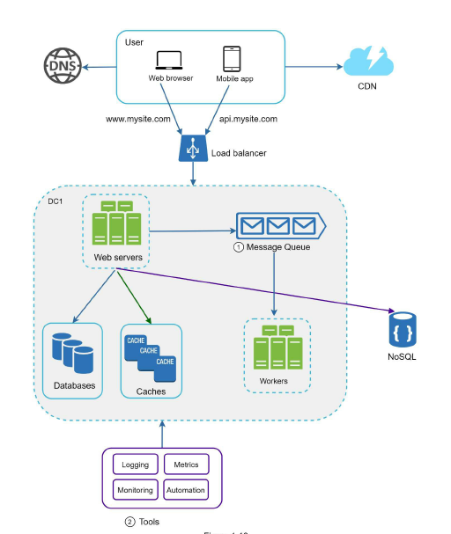
Architecture with shared DB / Loggings
Two Data centers and with shared DB / Workers and Logging
Every events are logged, monitored and automated.
These events are used for workflows, fraud detection, network analysis, and many more.

Slide 52
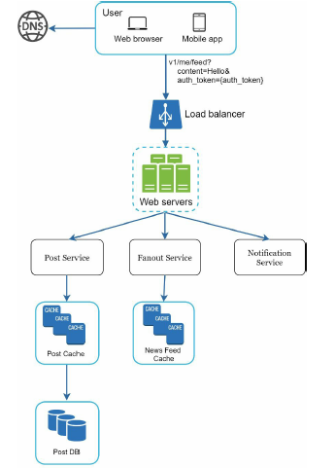
Typical Server with SOA
Post service stores post in database and cache.
Fanout service pushes new content to friend’s news feed. News feed is stored in the cache.
Notification service informs friend that the new content is available.

Slide 53
… Always remember, your architecture depends on your requirements.
… And there is endless possibilities.
All models are wrong, but some are useful. - George Box

Slide 54
Take Away
Designing any system depends on the requirements.
There is not perfect architecture for any enterprise. It depends on use cases.
Non-functional requirements often decides technical requirements.
Requirements, user flows and processes are often explored using tools like BPMN, UML, Process Mining etc.
Scalability, Performance, Security, Reliability and availability is essential quality attributes for enterprise applications.
Security is an essentials software Quality attributes which is out of scope of this lecture.
Lecture is inspired by book: System Design Interview by Alex Xu.

Slide 55
Further Questions
www.skmukhiya.com.np
(itsmeskm99@gmail.com)
We are continuously hiring Developers in Tryg Norge. Reach out to me for any IT roles.

